Slide 1
Introduction to Natural Language Processing (NLP)
Prepared by: ahmad alaa aldine
Presented by: ahmad alaa aldine

Slide 2
What is NLP?
NLP is the intersection of computer science, human language, and machine learning.
Goal: Help computers to understand and generate human language as well as we do.
Computer science
Machine Learning
NLP
Human Language

Slide 3
Why NLP is trending? (1/5)
Textual Resources Availability
Amount of online textual data
70 billion web-pages online
55 million Wikipedia articles
Growing fast
9000 tweets/second
3 million mail/second

Slide 4
Why NLP is trending? (2/5)
Free Available Pretrained Models
Fast text
https://fasttext.cc/
Tensorflow hub
https://www.tensorflow.org/hub
GPT3
https://platform.openai.com/docs/models/gpt-3

Slide 5







Why NLP is trending? (3/5)
Opensource Libraries

Slide 6
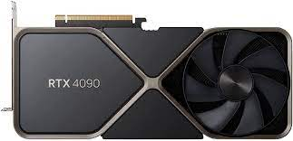


Why NLP is trending? (4/5)
Cheap and High Performance Hardware

Slide 7



Why NLP is trending? (5/5)
Cloud
Resources

Slide 8
Why NLP is Hard?
Productivity
New words, senses, structure are introduced in languages all the time
Examples: social distance was added to the Oxford Dictionary in 2021
Diversity
About 7000 languages spoken in the world
Ambiguity
Lexical Ambiguity: It was cool.
Syntactic Ambiguity: I saw the girl with the binocular.
Referential Ambiguity: Kiran went to Sunita. She said, I am hungry.

Slide 9
NLP Techniques
Rules and heuristics
Regular expression
Syntactic Analysis
Machine Learning
SVM
Naïve Bayes
Deep Learning
RNN
LSTM
Semantic Analysis
KNN
Decision Tree
Transformers
Word2Vec

Slide 10

Use Cases (1/7)
Question Answering
Question Answering focuses on building systems that automatically answer the questions asked by humans in a natural language.

Slide 11
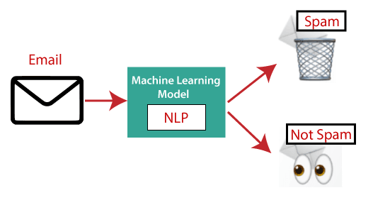
Use Cases (2/7)
Spam Detection
Spam detection is used to detect unwanted e-mails getting to a user's inbox.

Slide 12

Use Cases (3/7)
Sentiment Analysis
It is used to analyze the attitude, behavior, and emotional state of a text writer.
This application is implemented through a combination of NLP (Natural Language Processing) and machine learning to:
classify the text as positive, negative, or natural
identify the mood of the context as happy, sad, angry, etc

Slide 13
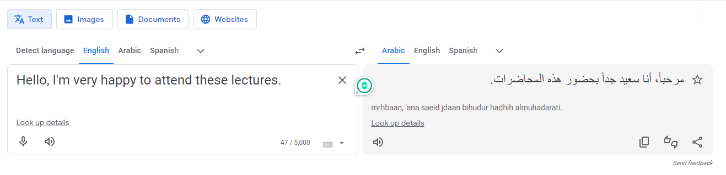
Use Cases (4/7)
Machine Translation
Machine translation is used to translate text or speech from one natural language to another natural language.

Slide 14
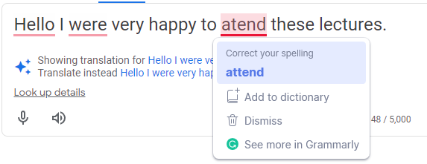
Use Cases (5/7)
Text Correction
Text correction is used to correct text from spelling, grammar, and punctuation mistakes.

Slide 15
Use Cases (6/7)
Information Extraction
Information extraction is one of the most important applications of NLP. It is used for extracting structured information from unstructured or semi-structured machine-readable documents.
Musk was born in Pretoria, South Africa, and briefly attended the University of Pretoria before immigrating to Canada at age 18, acquiring citizenship through his Canadian-born mother.
Born(Musk, Pretoria)
Hassan Kamel Al-Sabbah was a Lebanese electrical and electronics research engineer, mathematician and inventor. He was born in Nabatieh in present-day Lebanon.
Born(Hassan Kamel Al-Sabbah, Nabatieh)

Slide 16
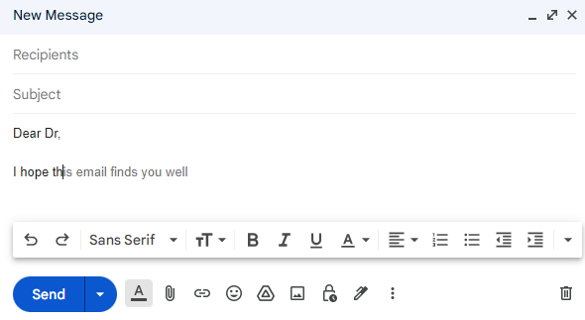
Use Cases (7/7)
Text Generation

Slide 17
Regular Expressions
Regular Expressions are a sequence of characters that define a search pattern.
They are used in NLP to search for specific patterns or structures in text data for:
Data Cleaning
Information Extraction
Regular expressions are highly expressive and can match many patterns, including numbers, dates, email addresses, and phone numbers.

Slide 18
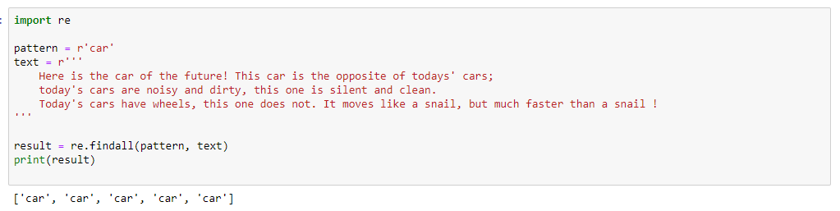
Regular Expressions
Use strings to build patterns

Slide 19
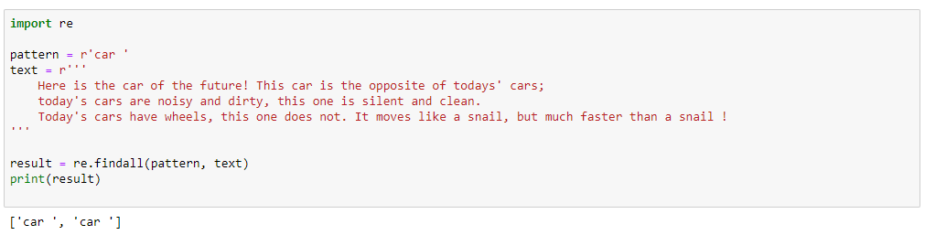
Regular Expressions
Use strings to build patterns

Slide 20
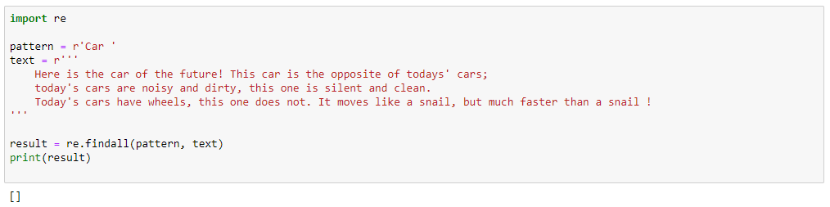
Regular Expressions
Regular expressions are case sensitive

Slide 21
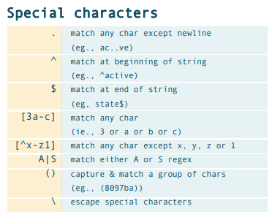
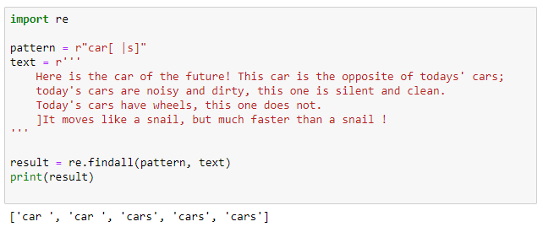
Regular Expressions
Use special characters to build more complex patterns

Slide 22
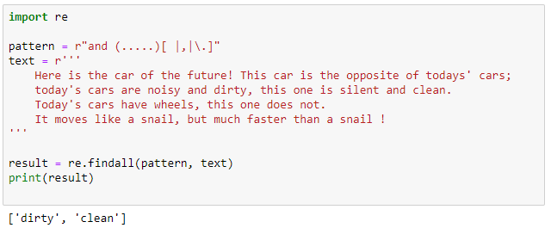
Regular Expressions
To build more complex patterns

Slide 23
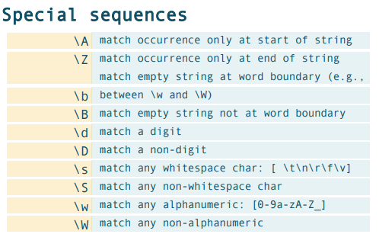
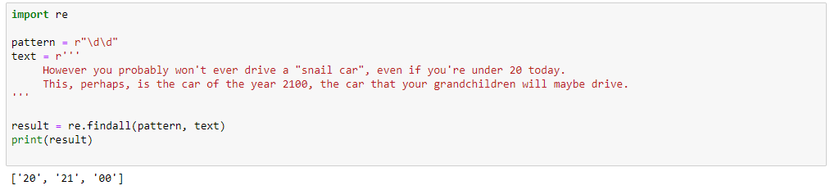
Regular Expressions
To build more complex patterns

Slide 24
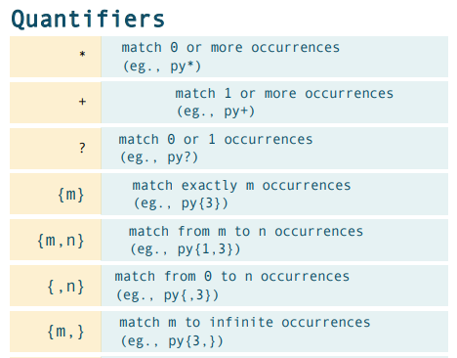
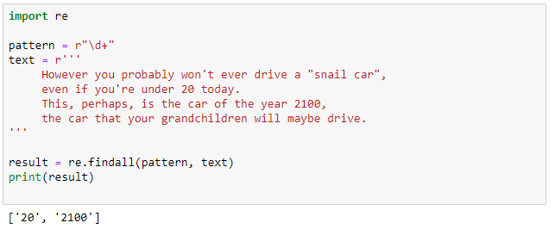
Regular Expressions
To build more complex patterns

Slide 25
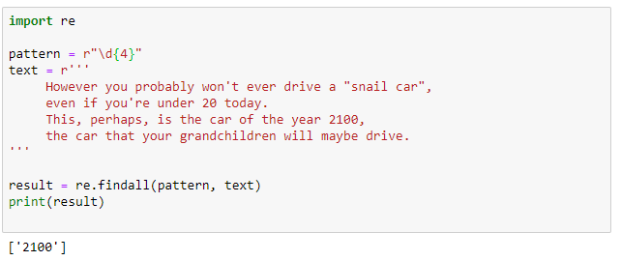
Regular Expressions
To build more complex patterns

Slide 26
Regular Expressions
Example 1
Write a regex pattern to find email addresses:
Here is my email address: aalaaeddein@gmail.com
I have another email address: Test.2@gmail.com
Here is my Outlook email: Test_1994@outlook.gov

Slide 27
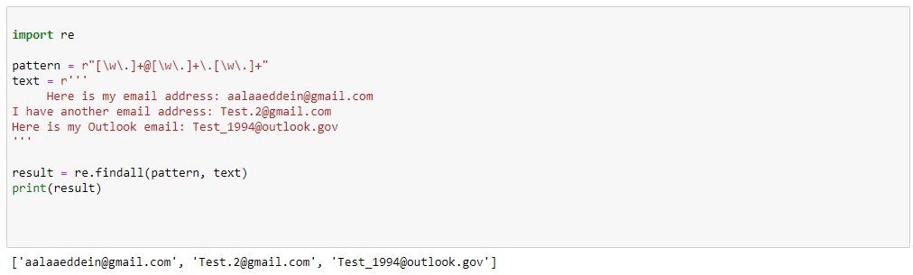
Regular Expressions
Solution

Slide 28
Regular Expressions
Example 2
Write a regex pattern to find Lebanese phone numbers:
Here is my phone number: 78888222
I have another number: 76 - 443 222
If you want to contact me from outside Lebanon use this: (+961) 71 321123

Slide 29
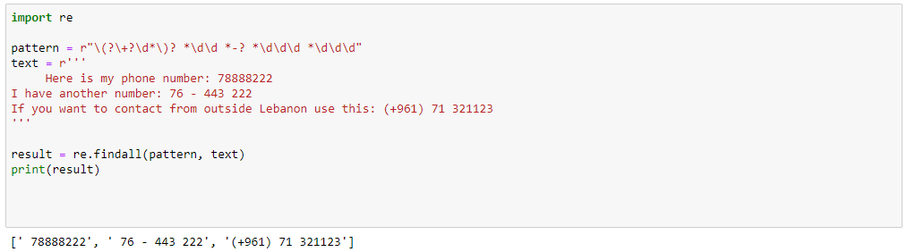
Regular Expressions
Solution

Slide 30
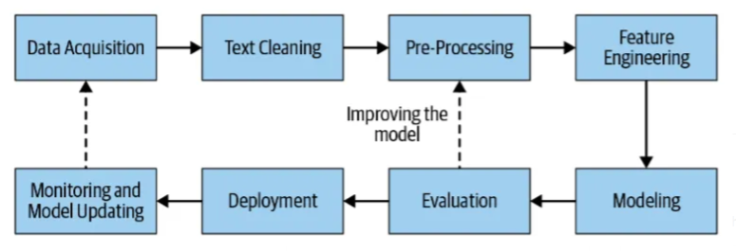
NLP Pipeline

Slide 31
Homework
Write a regex pattern to find only correct IP addresses:
19.232.111.0
222.265.111.111
132.1333.211.11
19.1.9.8
1.0.0.255
1.55.90.190
8.2.190

